Slide 1

Objects? No Thanks!
Using C++ effectively on small microcontrollers
Wouter van Ooijen MSc
Hogeschool Utrecht, Netherlands,
senior lecturer Computer Engineering
wouter.vanooijen@hu.nl
BeC++ 2016-06-30

Slide 2
Embedded – a meaning
Means:
part of something larger (not stand-alone)
subservient to that larger thing
with a dedicated task (not general-purpose).
Note that this does not imply a particular type of hardware or style of programming.
Often computer hardware is used for embedded systems that is the same or very similar to what is used on a desktop.

Slide 3
Embedded – some differences
The computer hardware is part of the product
The price of the hardware is reflected in the price of the product.
There is economic pressure to be efficient (use the cheapest posible hardware).
Often the ‘larger thing’ has (hard) real-time requirements.
The embedded system must (always) be fast enough.
Often the system is used to control real hardware.
➔ Failures have interesting consequences (up to loss of life).

Slide 4
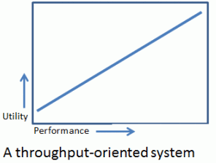
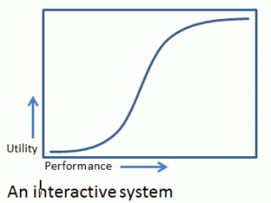
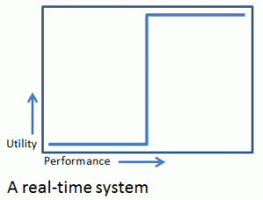
Real-Time
Means: utility depends critically on some timing parameter.
Variations (terms vary):
Soft real-time: usefulness degrades (rapidly)
Firm real-time: may occasionally be late or lower-quality

Slide 5

Soft real-time
usefulness degrades (rapidly) beyond the deadline
(if there was any to begin with…)

Slide 6
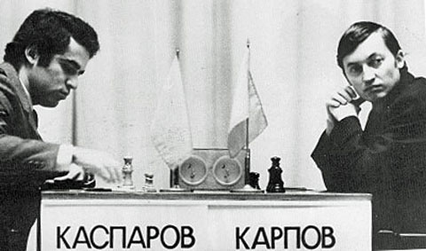
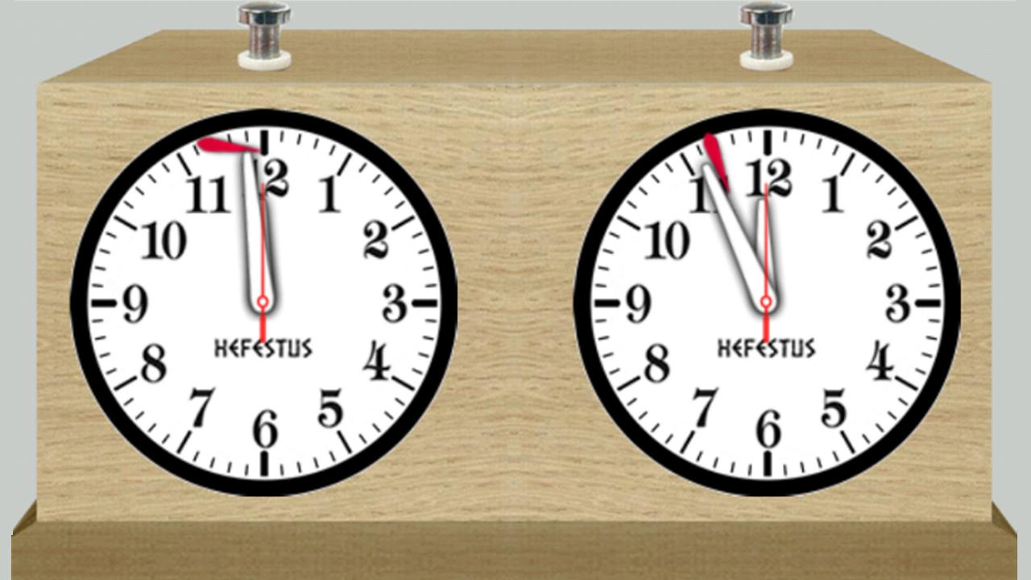
Firm real-time
If the perfect result can’t be calculated in time give what you have, but be on time!

Slide 7
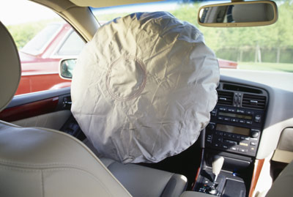
Hard real-time (and mission-critical)
Late might even be worse than not at all…

Slide 8

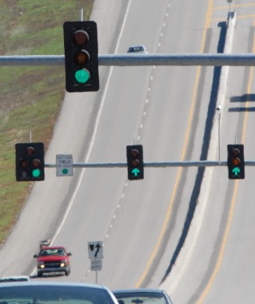

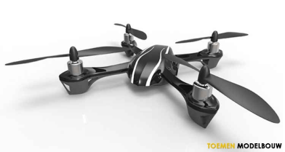
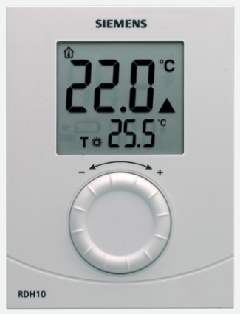

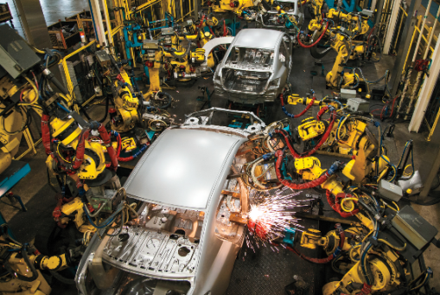


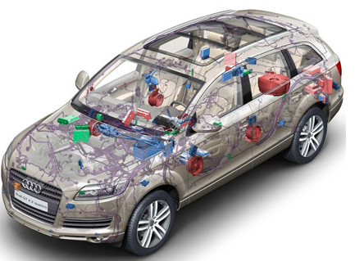
Embedded a wide range of seriousness
Consequently, a wide range of development styles: JBF*, Agile, prototyping, waterfall, …
* ”Jan Boere Fluitjes”: Dutch saying, meaning roughly ‘casual, with as little effort as possible’

Slide 9
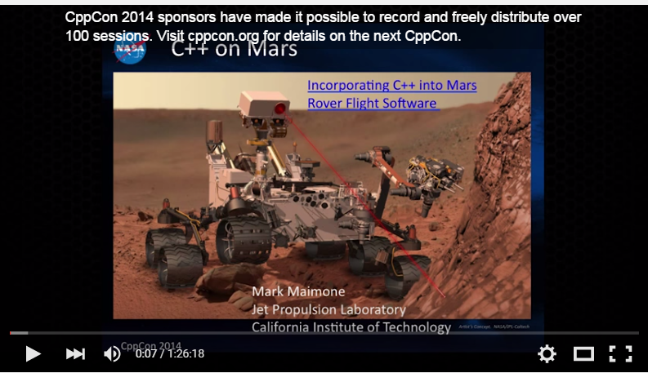

C++ in (very) serious embedded systems
CppCon 2014: Mark Maimone "C++ on Mars: Incorporating C++ into Mars Rover Flight Software"
CppCon2014: Bill Emshoff "Using C++ on Mission and Safety Critical Platforms"

Slide 10
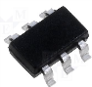
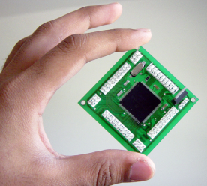
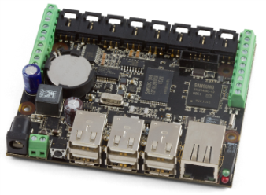
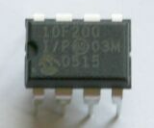
Embedded a wide range of hardware capabilities
1Kb
1Mb
1Gb

Slide 11
Embedded a wide range of hardware capabilities
1Kb
1Mb
1Gb
4-bit
64-bit
8-bit : 8051, PIC, AVR, …
No full standard C/C++
16-bit : MSP430, PIC, …
32-bit : ARM, MIPS, Intel, …

Slide 12

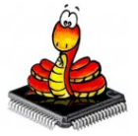


Embedded a wide range of hardware capabilities
1Kb
1Mb
1Gb
Wide range of ‘support software’:
Bare metal: libraries, but no OS
Desktop OS:
Linux
Windows
RTOS

Slide 13
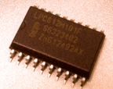
Some small micro-controllers
PIC12F200
8-bit CPU
256 Flash
16 RAM
€ 0.32@100
As yet no C++ compiler*:
8-bits
crazy CPU architecture
MKE04Z8VTG4 32-bit CPU
8k Flash
2k RAM
€ 0.46@100
A low-end chip for C++:
32 bits
Cortex-M0
GCC
* There are 8-bit CPUs that do support C++ (well, most of it).

Slide 14

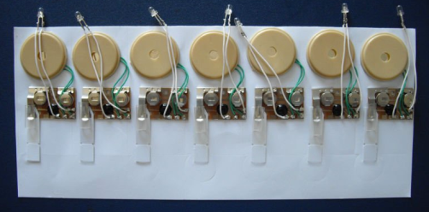

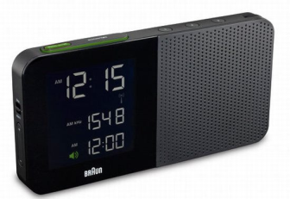
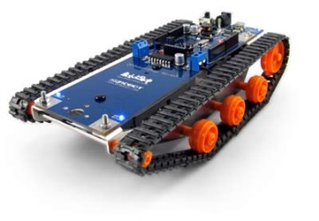
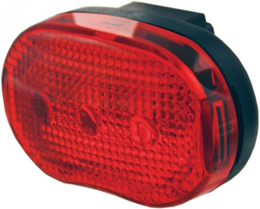
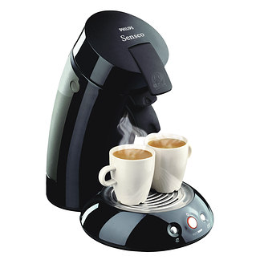
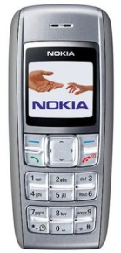
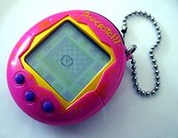
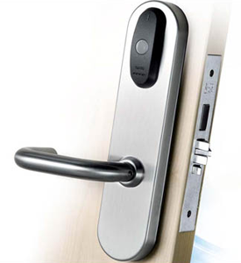
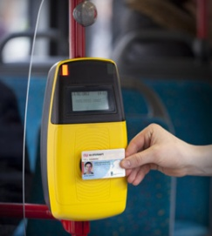
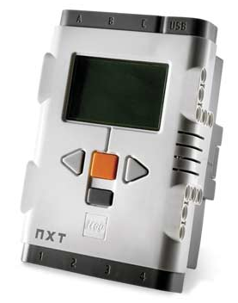
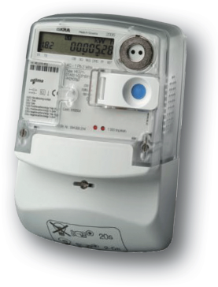
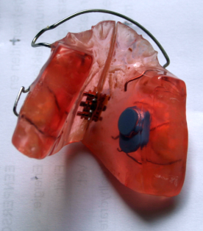
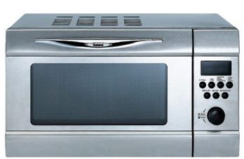
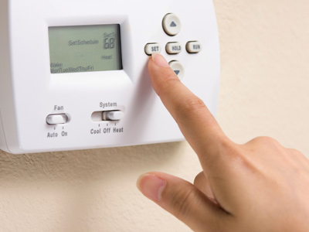

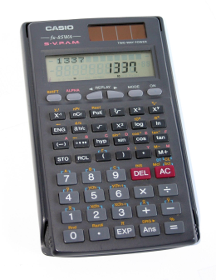
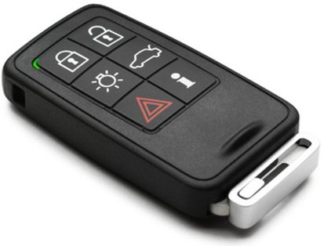
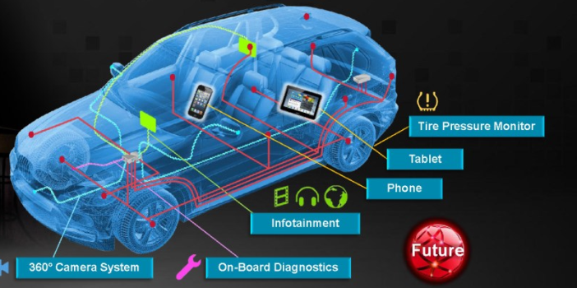
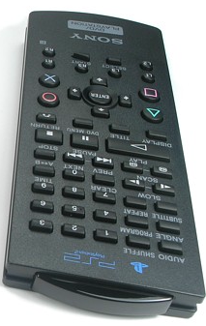
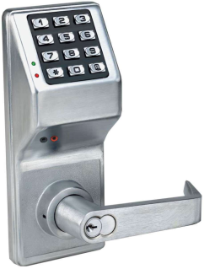
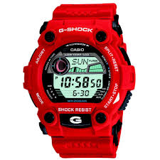
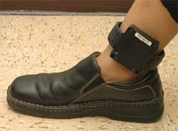
Micro-controllers are everywhere

Slide 15
Small micro-controller programming
Typically
Applications are small
Volumes are high
Worst-case timing constraints must be met (average timing is not important)
User-requirements are fixed (but hardware might change over time)
C dominates (even assembler is still used)

Slide 16
Small microcontroller economics
Product cost scales with use of resources:
CPU speed (power consumption!!)
code size (Flash)
data size (RAM)
Those prices are payed by the manufacturer, not by the end user (as for desktop software).
➔ Pressure on the developers to reduce resource use: every data byte or instruction counts (even if only in the perception of the managers).

Slide 17
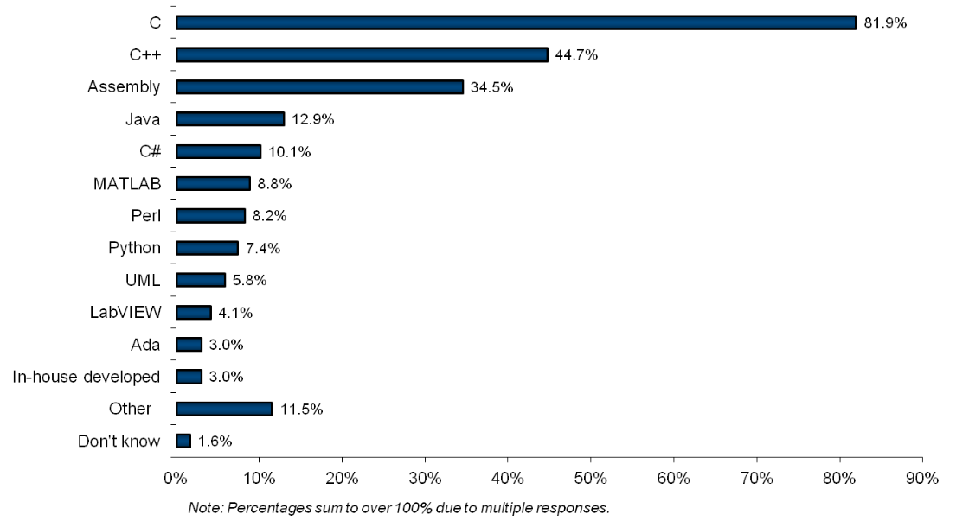
Embedded programming languages
VDC survey 2010; languages *used*, != LOC

Slide 18


Use across the spectrum
1Kb
1Mb
1Gb
C
Assembly
C++, C, Java, C#, Perl, Python, …

Slide 19
Code re-use
Is hindered by
Small size, so (perceived) benefit is small
Code is often written by electrical engineers
Lack of abstraction mechanisms in C
Each application has unique aspects, down to the lowest levels

Slide 20
Language use across the spectrum
1Kb
1Mb
1Gb
C++ gap
C
Assembly
C++, C, Java, C#, Perl, Python, …

Slide 21
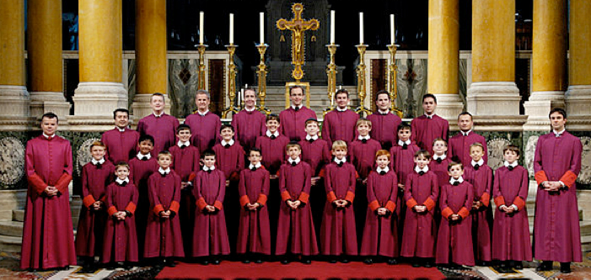
So why should C++ be used?
As a better C
(same programming style, less room for errors)
Enables other programming styles
(OO, functional, templates, . . .)
More opportunities for (efficient) code re-use

Slide 22

But not like C++ on a desktop…
Performance is different
Heap: forget it
Floating point: often not practical
Exceptions: debatable
C++ standard library: large parts are unusable
(heap, float/double, worst-case performance)
OO at run-time (virtuals): often not needed
ROM is scarce, RAM even more so
std::ostream, std::cout ??

Slide 23
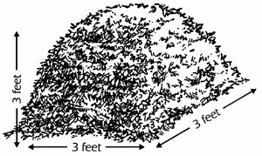
Heap
The heap is flexibility with respect to the amount of data, at the cost of (some) unpredictability in run-time and maximum available memory (fragmentation).
A typical small embedded system
has a rigidly prescribed task, including the size of the data involved
Must meet real-time constraints
Should be certain to meet work OK all the time (not just for a certain sequence of actions).
A heap and a small embedded system don’t match very well. Better:
Global allocation (!)
Fixed size pools or (better?) fixed size containers on the stack
Avoiding some dangling pointer is a nice extra ☺

Slide 24

Exceptions
Exceptions are great to handle a local problem that requires a (more) global response.
A small system often has a rather simple, rigidly defined task
there are no exceptions, only different situations.
No heap ➔ one reason less to use exceptions.
Exception implementation often uses the heap….
Straw man: exceptions are slow and have unpredictable timing.

Slide 25
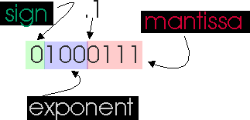
Floating point
FP is useful when a wide dynamic range is needed. For an embedded application the ranges are often very well known.
Small micro-controllers often don’t have a hardware FPU. A software FP library
Is considerably slower
Generally not needed (value range is known)
Takes up ROM

Slide 26
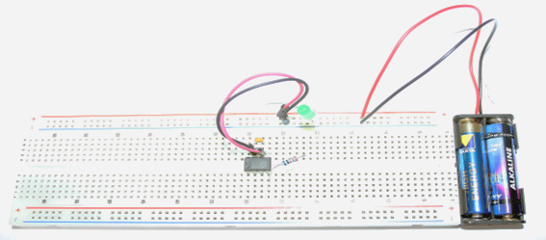
C++ test case: blink a LED
The embedded equivalent of ”Hello world”

Slide 27
Blink a LED in C
// return the pointer to an IO port related register
#define GPIOREG( port, offset ) \
(*(volatile int *)( 0x50000000 + (port) * 0x10000 + (offset)))
// set the pin port.pin to value
#define PIN_SET( port, pin, value ) \
{ GPIOREG( (port), 0x04 << (pin) ) = (value) ? -1 : 0; }
int main(){
for(;;){
PIN_SET( 1, 0, 1 );
delay();
PIN_SET( 1, 0, 0 );
delay();
}
}
.L97:
ldr r4, .L98 // get the I/O register address
mov r3, #1 // get -1 into r3
neg r0, r3
str r0, [r4] // store -1 in the I/O register
bl delay
mov r1, #0
str r1, [r4] // store 0 in the I/O register
bl delay
b .L97
.align 2
.L98:
.word 1074036740
Some ugly details (initialization, timing, …) have been omitted to concentrate on making the pin high and low.

Slide 28
PIN_SET( 1, 0, 1 )
// set the pin port.pin to value
#define PIN_SET( port, pin, value ) \
{ GPIOREG( (port), 0x04 << (pin) ) = (value) ? -1 : 0; }
Abstraction of an I/O pin
+ Efficient
- Can’t easily be replaced or augmented by the user
- It is a macro! (scope, textual parameters, … )

Slide 29
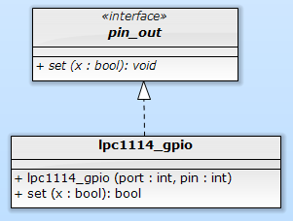
Classic OO pin abstraction
struct pin_out {
virtual void set( bool ) = 0;
};
volatile int & gpioreg( int port, int offset ){
return * (volatile int *) ( 0x50000000 + port * 0x10000 + offset );
}
struct lpc1114_gpio : public pin_out {
const int port, pin;
lpc1114_gpio( int port, int pin )
: port{ port }, pin{ pin }{}
void set( bool x ) override {
gpioreg( port, 0x04 << pin ) = x ? -1 : 0;
}
};
void blink( pin_out & pin ){
for(;;){
pin.set( 1 );
delay();
pin.set( 0 );
delay();
}
}
int main(){
lpc1114_gpio led( 1, 0 );
blink( led );
}
Abstract class with virtual functions

Slide 30
Metrics
for set(1) + set(0) + ‘support’ code
PIN_SET( 1, 0, 1 );
PIN_SET( 1, 0, 0 );
pin.set( 1 );
pin.set( 0 );
 | C (macro) | C++ (virtual functions)
Code (bytes Flash) | 16 | 68
RAM | 0 | 12
CPU cycles | ~ 9 | ~ 56
☹
What has gone wrong?

Slide 31
Generated code (C++ OO-style)
void blink( pin_out & pin ){
for(;;){
pin.set( 1 );
delay();
pin.set( 0 );
delay();
}
}
int main(){
lpc1114_gpio led( 1, 0 );
blink( led );
}
push {r4, lr}
mov r4, r0
.L12:
ldr r3, [r4]
mov r0, r4
ldr r3, [r3]
mov r1, #1
blx r3
bl _Z5delayv
ldr r3, [r4]
mov r0, r4
ldr r3, [r3]
mov r1, #0
blx r3
bl _Z5delayv
b .L12
24
_ZN12lpc1114_gpio3setEb:
ldr r3, [r0, #4]
push {r4, lr}
mov r4, #160
lsl r4, r4, #7
add r2, r3, r4
ldr r3, [r0, #8]
mov r0, #4
lsl r2, r2, #16
lsl r0, r0, r3
add r3, r2, r0
neg r1, r1
str r1, [r3]
pop {r4, pc}
ldr r3, .L14
add r0, sp, #4
str r3, [sp, #4]
mov r3, #1
str r3, [sp, #8]
mov r3, #0
str r3, [sp, #12]
bl _Z5blinkR7pin_out
.align 2
.L14:
.word 1342177284
18
26

Slide 32
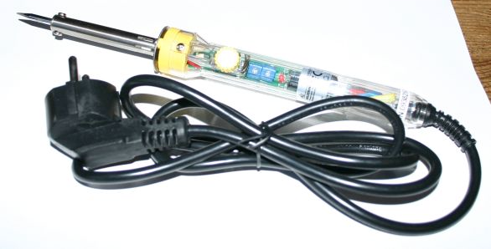
Why so much code?
Run-time polymorphism:
Connection between operation and implementation is made at run time
This takes code, CPU cycles, even some RAM, and blocks optimizations
Fixed-hardware embedded systems don’t need such run-time flexibility, but
Efficient use of libraries does require compile-time flexibility

Slide 33
Alternative: compile-time polymorphism
Static classes (or structs) can be used as compile-time encapsulation of data and operations.
Template parameters can be used to pass such an encapsulation to another one.
These are compile-time-only actions, hence fully visible to the optimizer.

Slide 34
Run-time polymorphism
Compile-time polymorphism
struct pin_out {
virtual void set( bool ) = 0;
};
struct lpc1114_gpio : public pin_out {
lpc1114_gpio( . . . ) . . .
void set( bool x ) override { . . . }
};
struct blink {
pin_out & pin;
blink( pin_out & pin ): pin( pin ){}
void run(){
. . .
pin.set( 1 );
}
}
int main(){
blink( lpc1114_gpio( 1, 2 )).run();
}
struct pin_out_archetype {
typedef void has_pin_out;
static void set( bool value ){}
}
template< int port, int pin >
struct lpc1114_gpio : public pin_out_archetype {
static void set( bool value ){ . . . }
};
template< typename pin >
struct blink {
void run(){
. . .
pin::set( 1 );
}
}
int main(){
blink< lpc1114_gpio< 1, 2 >>::run();
}
As before, some ugly details (initialization, timing, …) are omitted.

Slide 35
Generated code (C versus C++ C-T-P)
// C with macro’s
.L97:
ldr r4, .L98
mov r3, #1
neg r0, r3
str r0, [r4]
bl delay
mov r1, #0
str r1, [r4]
bl delay
b .L97
// C++ with compile-time polymorphism
.L3:
ldr r4, .L5+12
mov r3, #1
neg r3, r3
str r3, [r4]
ldr r0, .L5+16
bl _...waiting_324waitEj
mov r3, #0
str r3, [r4]
ldr r0, .L5+16
bl _...waiting_324waitEj
b .L3
 | C | C++
Code (bytes Flash) | 16 | 16
RAM | 0 | 0
CPU cycles | ~ 9 | ~ 9
☺

Slide 36
Blink: some (ugly?) details
#include "targets/lpc1114fn28.hpp"
typedef hwcpp::lpc1114fn28<> target;
int main(){
hwcpp::blink< target::gpio_1_2, target::waiting >::run();
}
template<
typename arg_pin,
typename arg_timing
> struct blinking {
typedef pin_out_from< arg_pin > pin;
typedef waiting_from< arg_timing > timing;
typedef typename timing::duration duration;
static void run( const duration t = duration::ms( 500 ) ){
timing::init();
pin::init();
for(;;){
pin::set( 1 );
timing::wait( t / 2 );
pin::set( 0 );
timing::wait( t / 2 );
}
}
};
#include "targets/lpc1114fn28.hpp"
typedef hwcpp::lpc1114fn28<> target;
int main(){
hwcpp::blink< target::gpio_0_0, target::waiting >::run();
}
Type narrowing
Explicit initialization

Slide 37
Four pin archetypes
struct pin_in_archetype {
typedef void has_pin_in;
static void init();
static bool get();
};
struct pin_out_archetype {
typedef void has_pin_out;
static void init();
static void set( bool value );
};
struct pin_in_out_archetype {
typedef void has_pin_in_out;
static void init();
static void direction_set_input();
static void direction_set_output();
static bool get();
static void set( bool value );
};
struct pin_oc_archetype {
typedef void has_pin_oc;
static void init();
static bool get();
static void set( bool value );
};

Slide 38
Type narrowing
class target {
typedef . . . pin_a0;
}
typedef target::pin_a0 alarm;
int main(){
alarm::init();
alarm::direction_set_output();
alarm::set( false );
if( . . . ){
alarm::set( true );
}
}
class target {
typedef . . . pin_a0;
}
typedef pin_out_from< target::pin_a0 > alarm;
int main(){
alarm::init();
alarm::direction_set_output();
alarm::set( false );
if( . . . ){
alarm::set( true );
}
}
The template parameter is type-checked
The template adapts to the parameter type
Initialization is ‘complete’
The code can’t accidentally use an inappropriate method

Slide 39
pin_out_from< . . . > template
template< class unsupported, class dummy = void > struct pin_out_from {
static_assert( sizeof( unsupported ) == 0, . . . ); };
template< class pin > struct pin_out_from < pin, typename pin::has_pin_out > :
public pin_out_archetype
{
static void init(){ pin::init(); }
static void set( bool value ){ pin::set( value ); }
};
template< class pin > struct pin_out_from < pin, typename pin::has_pin_oc > :
public pin_out_archetype
{
static void init(){ pin::init(); }
static void set( bool value ){ pin::set( value ); }
};
template< class pin > struct pin_out_from < pin, typename pin::has_pin_in_out > :
public pin_out_archetype
{
static void init(){ pin::init(); pin::direction_set_output(); }
static void set( bool value ){ pin::set( value ); }
};
template< class unsupported, class dummy = void > struct pin_out_from {
static_assert( sizeof( unsupported ) == 0, . . . ); };
template< class pin > struct pin_out_from < pin, typename pin::has_pin_out > :
public pin_out_archetype
{
static void init(){ pin::init(); }
static void set( bool value ){ pin::set( value ); }
};
template< class pin > struct pin_out_from < pin, typename pin::has_pin_oc > :
public pin_out_archetype
{
static void init(){ pin::init(); }
static void set( bool value ){ pin::set( value ); }
};
template< class unsupported, class dummy = void > struct pin_out_from {
static_assert( sizeof( unsupported ) == 0, . . . ); };

Slide 40

Don’t say it in a comment
invert< . . . >
decorator
namespace target {
typedef . . . pin_a0;
}
typedef target::pin_a0 alarm_led;
// the alarm LED pin is active low
constexpr bool alarm_led_active = false;
int main(){
alarm_led::set( ! alarm_led_active );
if( . . . ){
alarm_led::set( alarm_led_active );
}
}
Say it in the code
namespace target {
typedef . . . pin_a0;
}
typedef invert< target::pin_a0 > alarm_led;
int main(){
alarm_led::set( false );
if( . . . ){
alarm_led::set( true );
}
}

Slide 41
Pin invert< . . . > template
template< class unsupported, class dummy = void > struct invert {
static_assert( sizeof( unsupported ) == 0, ". . ." ); };
template< class pin > struct invert< pin, typename pin::has_pin_in > :
public pin_in_archetype {
static void init(){ pin::init(); }
static bool get(){ return ! pin::get(); } };
template< class pin > struct invert< pin, typename pin::has_pin_out > :
public pin_out_archetype {
static void init(){ pin::init(); }
static void set( bool x ){ pin::set( ! x ); } };
template< class pin > struct invert< pin, typename pin::has_pin_in_out > :
public pin_in_out_archetype {
static void init(){ pin::init(); }
static void direction_set_input(){ pin::direction_set_input(); }
static void direction_set_output(){ pin::direction_set_output(); }
static void set( bool x ){ pin::set( ! x ); }
static bool get(){ return ! pin::get(); } };
template< class pin > struct invert< pin, typename pin::has_pin_oc > :
public pin_oc_archetype {
static void init(){ pin::init(); }
static void set( bool x ){ pin::set( ! x ); }
static bool get(){ return ! pin::get(); } };
Often:
ZERO cost!

Slide 42
Some more pin & port decorators
// create the stated pin or port type from p
pin_in_from< p >
pin_out_from< p >
pin_in_out_from< p >
pin_oc_from< p >
port_in_from< p >
port_out_from< p >
port_in_out_from< p >
port_oc_from< p >
// create a port of the stated type from pins
port_in_from_pins< p, ... >
port_out_from_pins< p, ... >
port_in_out_from_pins< p, ... >
// invert the value read from or written to p
invert< p >
// pin or port that writes to all pins or ports
all< p, ... >

Slide 43
Using static class templates: consequences (1)
Abstraction tool is the class template with only static contents (classes, methods, attributes)
Composition is by template instantiation
Method call syntax is class::method(…) instead of object.method(…)
Header-only

Slide 44
Using static class templates: consequences (2)
No objects (of such classes) are created
No memory management, no dangling references
Sharing of identical constructs is automatic
No automatic construction: explicit init() calls
Overhead can be zero

Slide 45

Long term view
A use case
Write library code for reading the temperature from an LM75 chip (I2C interface). Write it once and for all.
What should be in this code?
Getting the data bits from the LM75 (using I2C)
Converting the data bits to a temperature
Maybe detecting errors in the data bits (passing I2C errors along?)
What should NOT be in this code?
I/O pin handling
I2C protocol
Timing
Conversion to the requested datatype (int, float, double, fixed-point, … )
Conversion to the requested unit (Kelvin, Celcius, Fahrenheit, … )
Floating point calls

Slide 46
Next steps
Identify and/or implement abstraction(s) for
Values (units, fixed-point)
Timing (including multithreading)
Error handling
Handle parallel hierachies (mix with objects)

Slide 47
Devirtualization?
Compilers are starting to do devirtualization (as part of whole-program optimization). How would perfect de-virtualization compare to the static-class-template approach?
Objects + ideal devirtualization | Static class templates
Run-time allocation | Compile/link time allocation
Global, stack or heap allocation | Only global allocation
Danger of dangling references | No such danger
Run-time flexibility | Requires extra effort
Sharing requires planning | Sharing is automatic (prevention is tricky)
Well-known syntax & style | Unfamiliar syntax & style

Slide 48
C++ language issues
Class templates and plain classes can’t have the same name.
The syntax for using static attributes of class templates can be horrible.
A LOT of template and typename prefixes can be required to disambiguate (template parameter-) dependent names.
C++0x11 has override for virtual methods, but there is no equivalent for static methods.

Slide 49
Summary
Current C++ libraries and programming practices are often not optimal for very small systems.
Compile-time polymorphism using static class templates (no objects!)
Can be as efficient as C macro’s.
Has an abstraction power comparable in power but very different in nature to classic run-time-objects-based OO.
There is a lot of interesting work to do to create C++ libraries that help programming very small systems.

